Slide 1
Question Words
Who, what, where, when.

Slide 2
WHO

Slide 3
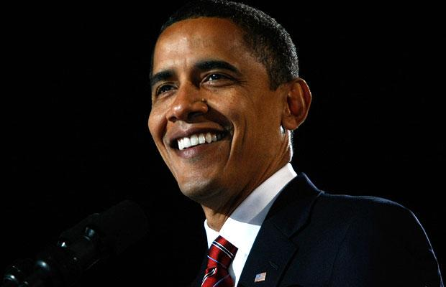
Who is this?
It’s Barak Obama.

Slide 4
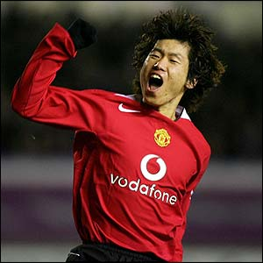
Who is he?
He is Park Ji Sung.

Slide 5
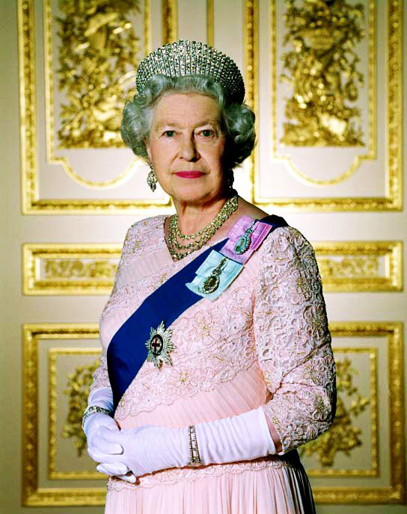
Who is she?
She is the Queen.

Slide 6
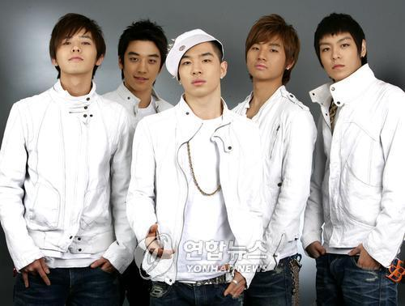
Who are they?
They are Big Bang.

Slide 7
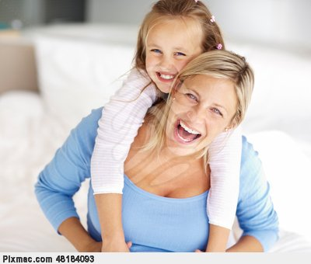
Who is that woman?
She is my mum.

Slide 8
Who is your favourite
Singer?

Slide 9
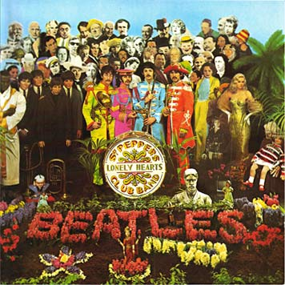
‘WHO’ is for People.

Slide 10
WHAT

Slide 11
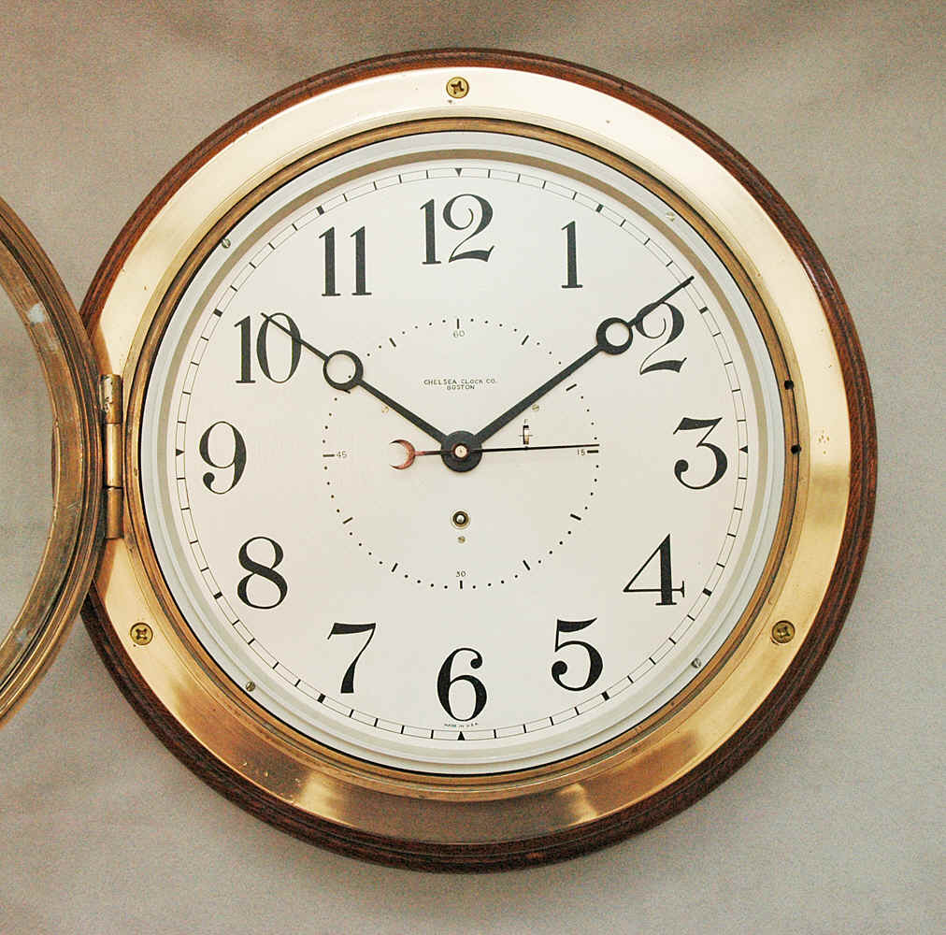
What is that?
It’s a clock.

Slide 12
What is this?
This is an umbrella.

Slide 13
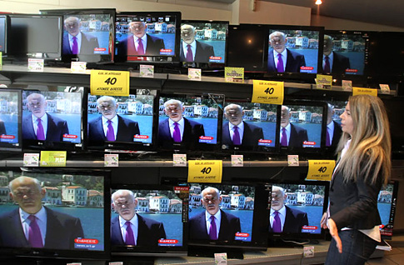
What are those?
Those are TV’s.

Slide 14
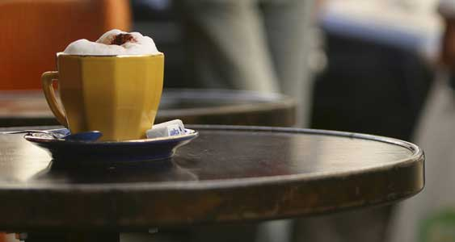
What is on the table?
A cup of coffee is
on the table.

Slide 15
What is your name?

Slide 16
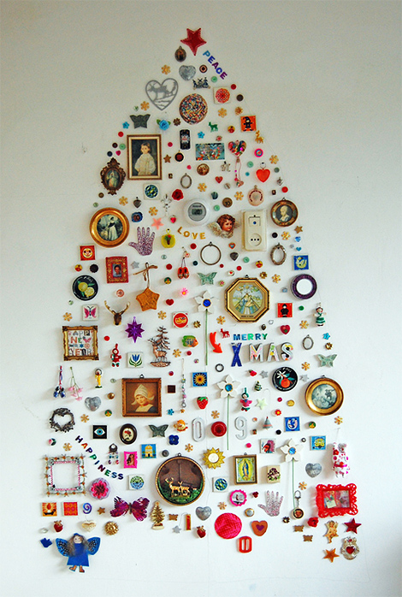
‘WHAT’ is for names
Of things.

Slide 17
WHERE

Slide 18
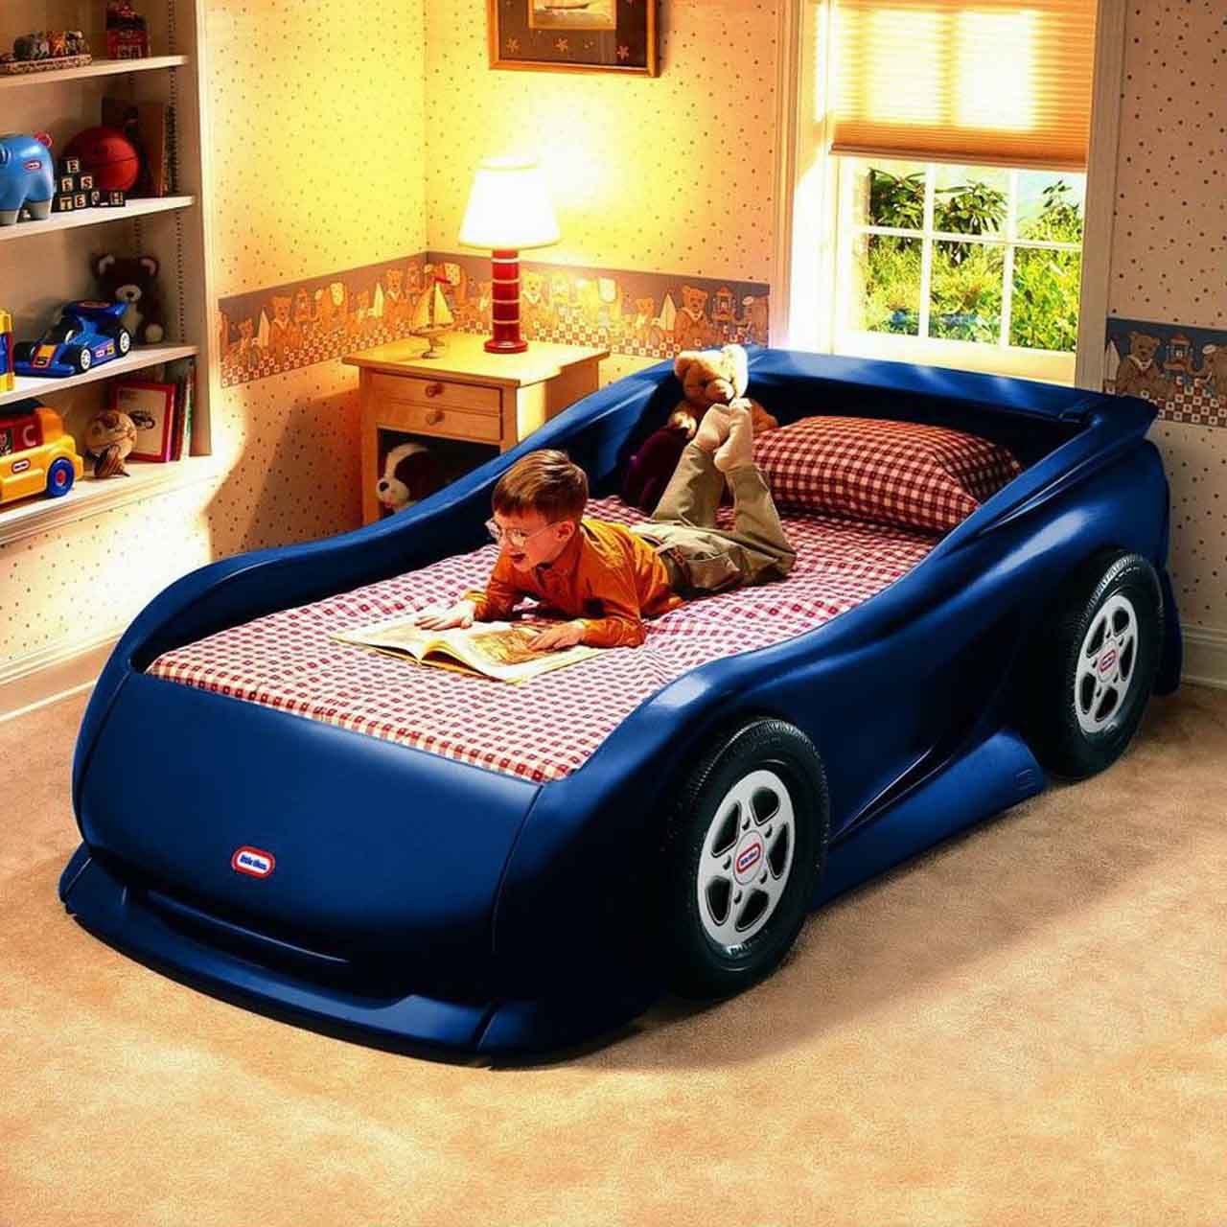
Where is John?
John is in the bedroom.

Slide 19
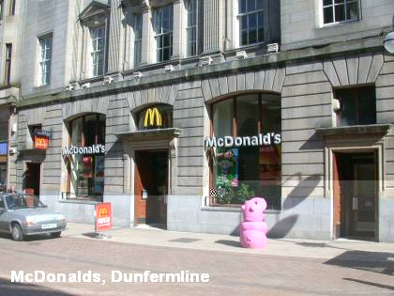
W here is McDonalds?
McDonalds is on
the high street.

Slide 20
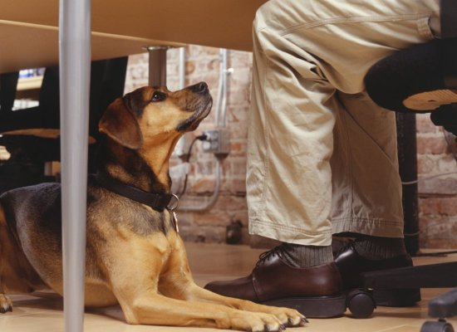
Where is the dog?
The dog is under the desk.

Slide 21
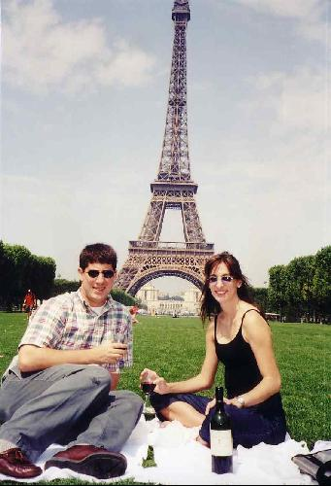
Where are they?
They are in France.

Slide 22
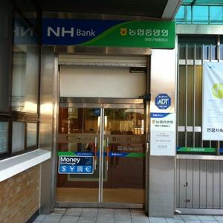
Where are you going?
I am going to the bank.

Slide 23
Where are we?

Slide 24
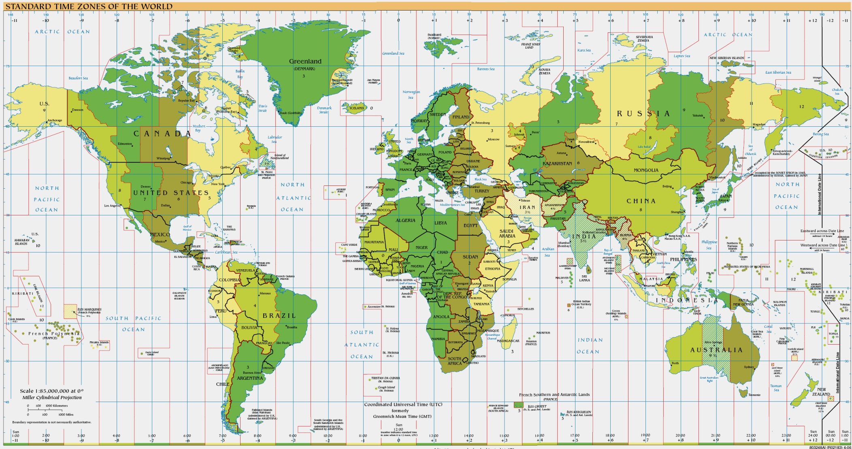
Where is for a place.

Slide 25
WHEN

Slide 26
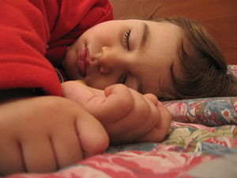
When do you sleep?
I sleep at night time.

Slide 27
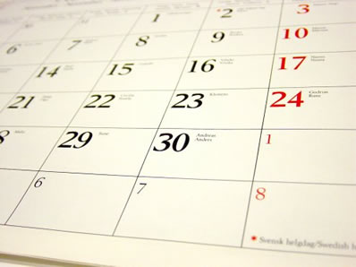
When is your birthday?
My birthday is 31st August.

Slide 28
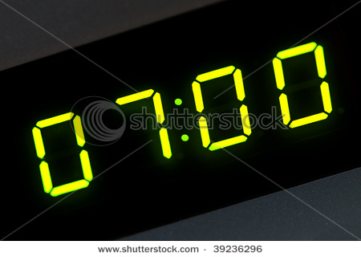
When do you eat dinner?
I eat dinner at seven ‘o’
Clock.

Slide 29
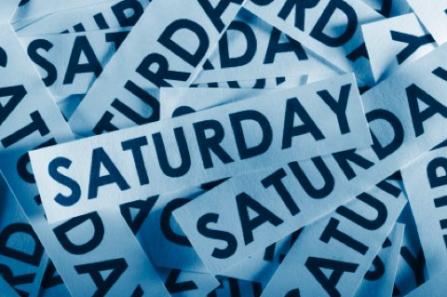
When is the party?
The party is on Saturday.

Slide 30
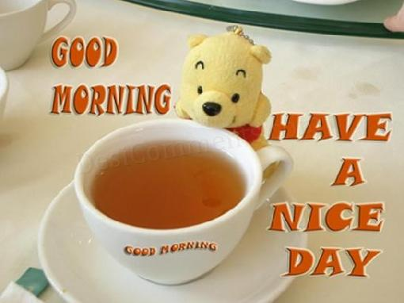
When do you eat breakfast?
I eat breakfast in the
Moring.

Slide 31
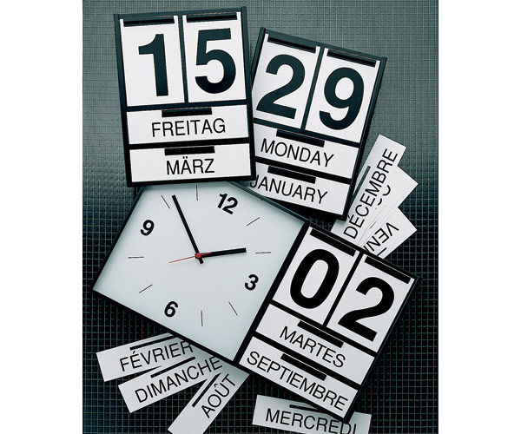
When is for time or date.

